Slide 1

Churn Analysis in Subscription-Based Businesses from Prediction to Inference
Mid-project update and presentation
Reported by Group 18
Supervisor: David Hason
Speakers: Yangyang, Weilin, Jim, Sammi
The report date: 04/20/2022

Slide 2
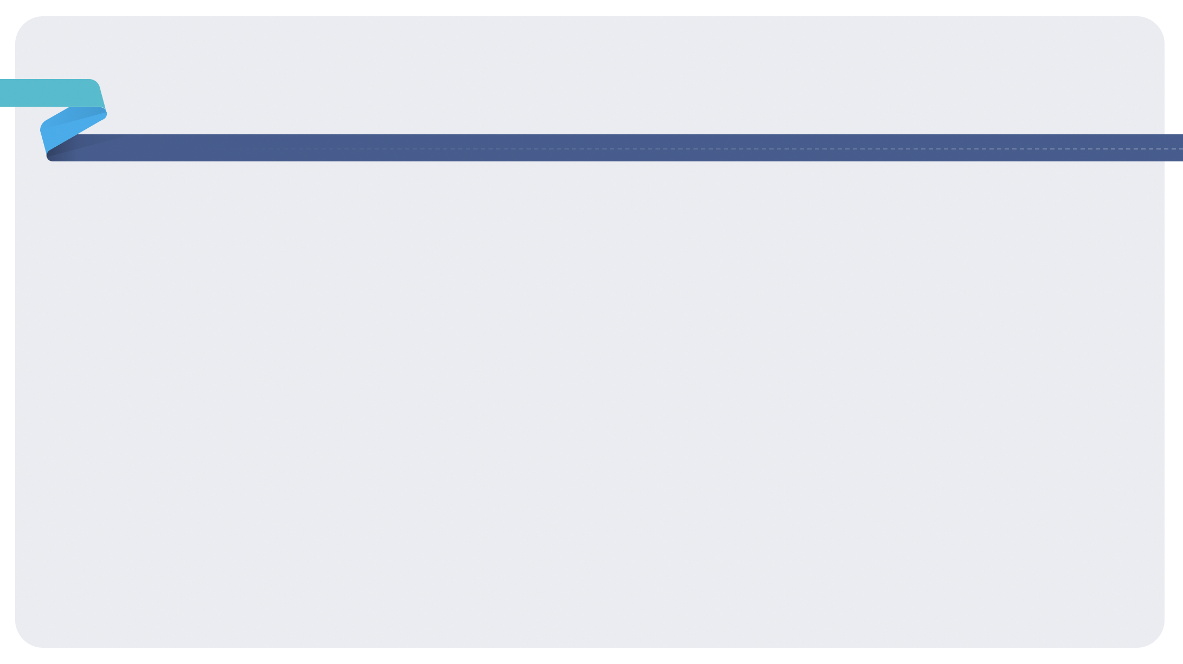
Contents
1
Project Description
2
Data Exploration
3
Initial Finding
4
Challenges Encountered
5
Updated Project Plan

Slide 3

1.0 Project Description
Project Background
Business Problem
Available Solution

Slide 4
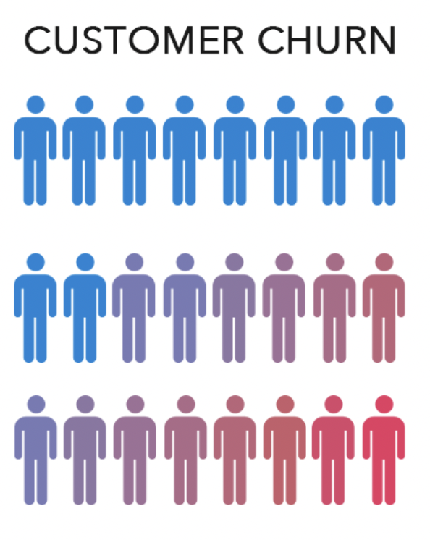


Project Description
Churn Analysis
Churned Customer:
Customers no longer participate in the business, discontinue services they previously used, or break away from existing groups (e.g., high-value customer groups)
Impact of Customer Churn
If there is a series of unhappy customer churn, both the loss of profits and the damage to the company's reputation can be huge.

Slide 5

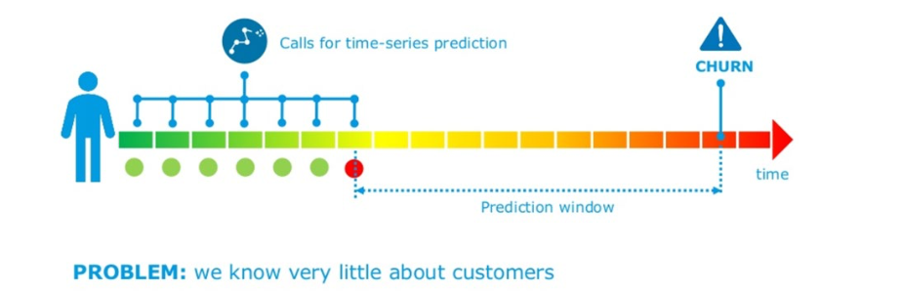
Project Description
Churn Analysis
Business Problem:
The cost of acquiring new customers and rate of customer churn, both are increasing at a rapid pace
The average churn rate is high
The high rate of customer churn leads to a decline in the company’s profitability
We know very little about members data

Slide 6
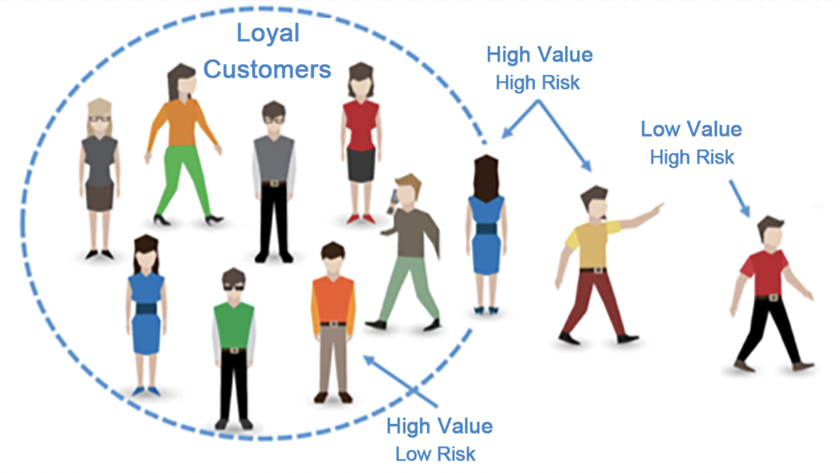
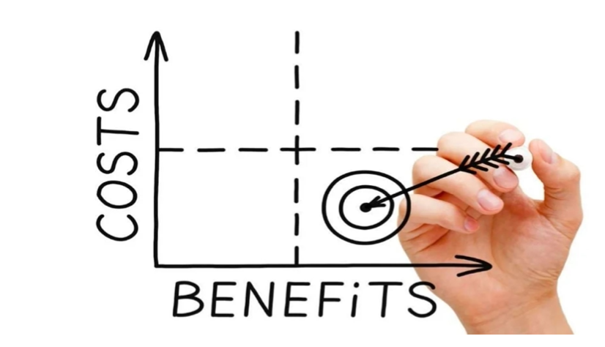
Project Description
Churn Analysis
Available Solution:
Need to build a robust churn propensity model that can classify and score each customer's churn over the next six months.
Employed causal Bayesian networks to predict cause probabilities that lead to customer churn and determine dependency levels between features

Slide 7
2.0 Data Exploration
Where is the data from?
How do we preprocess or clean the data?
What are the results of the data audit？
What have we discovered in the data？

Slide 8
Data Exploration
Churn Analysis
Data description:
The data set was collected from CFS customers' membership records for June and December 2015, including age, account tenure, savings plans, billing information, service records. etc.
The volume of this dataset is relatively large, a single dataset contains nearly 270,000 member records and 88 behavioural attributes

Slide 9
Data Exploration
Churn Analysis
How do we preprocess or clean the data?
Data integration:
To save data storage space and improve write performance, thereby improving the model accuracy
One-Hot Encoding:
Make our training data easier to use and more expressive
Data normalization
Eliminate the dimension and simplify the model, thus speeding up the calculation.

Slide 10
Data Exploration
Churn Analysis
What are the results of the data audit？
To satisfy model performance, two main inclusion criteria are applied:
Only retained data on customers older than six months.
Removed account balances below $1,500 to improve forecasts

Slide 11
3.0 Initial Finding
Age distribution, and Relationship between age and churn
The relationship between acc_tenure and churn
The relationship between acc_balance and churn
Number of investment options
The relationship between customer account balance change and Churn
The weight diagram of feature importance

Slide 12
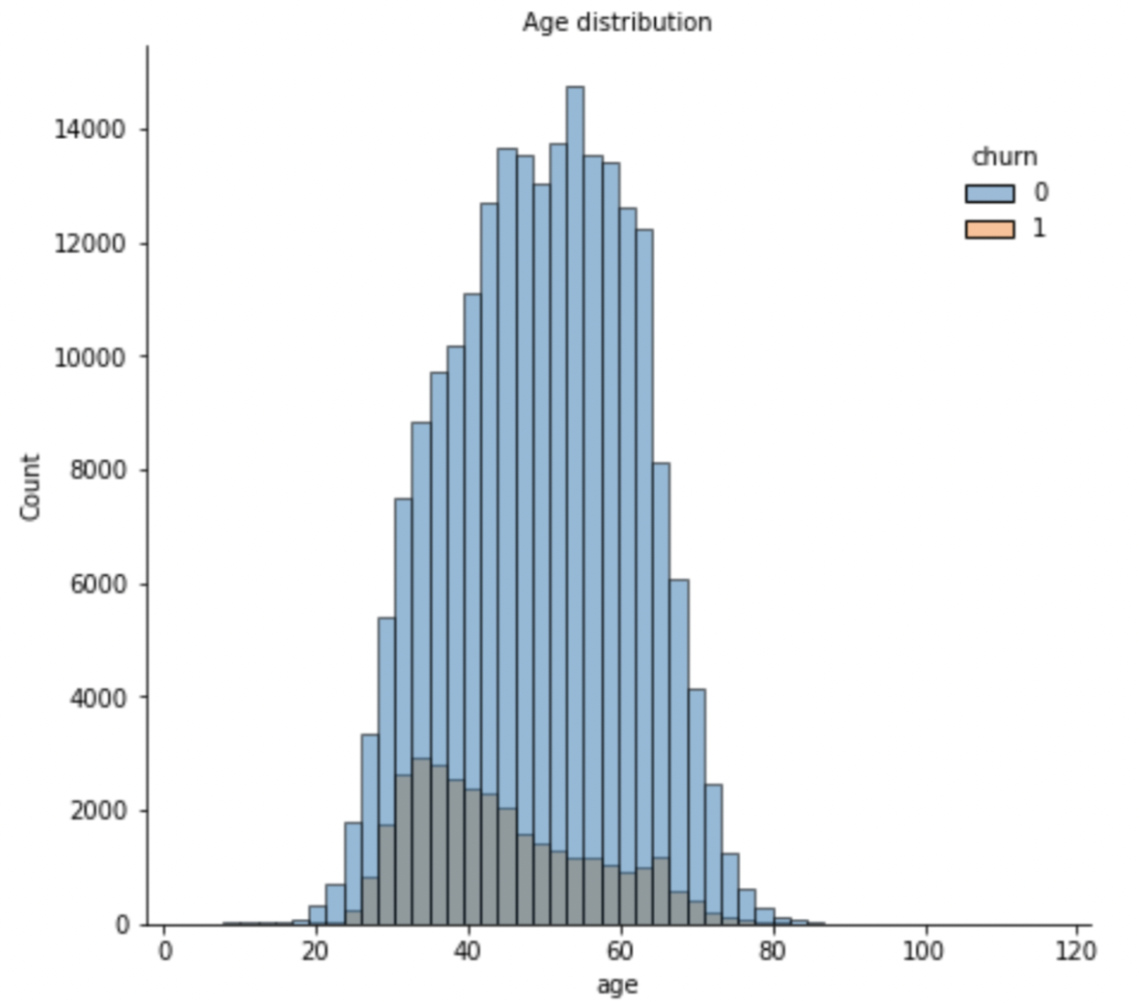
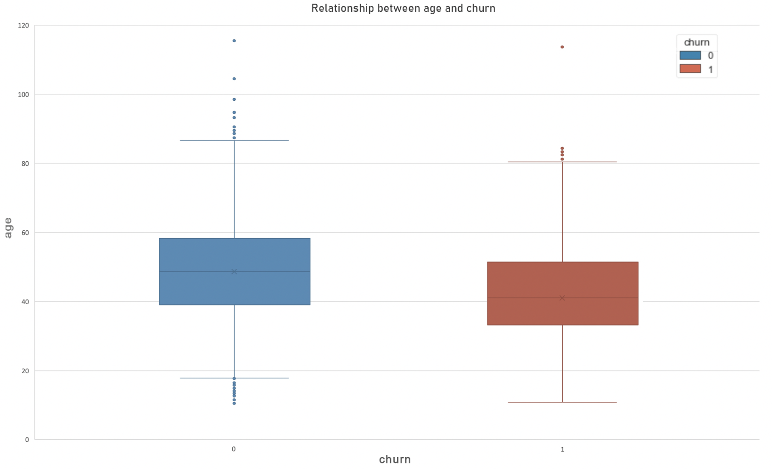
Initial Finding
Churn Analysis
Observation:
People who use the superannuation fund range from 20 to 80 years old
Mainly concentrated in the middle-aged group of 40 to 60 years old
The age of churn customers is generally lower than that of non-churn customers

Slide 13
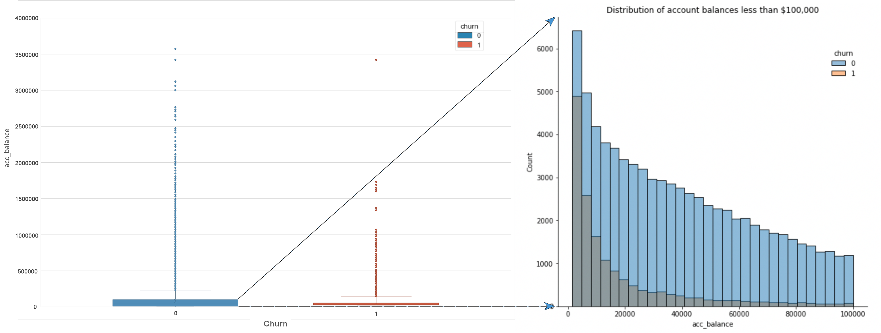
Initial Finding
Churn Analysis
Observation:
Customers' account balances are mainly distributed within $100,000
A considerable proportion of account balances are low
The churn rate of these low-balance customers is very high

Slide 14
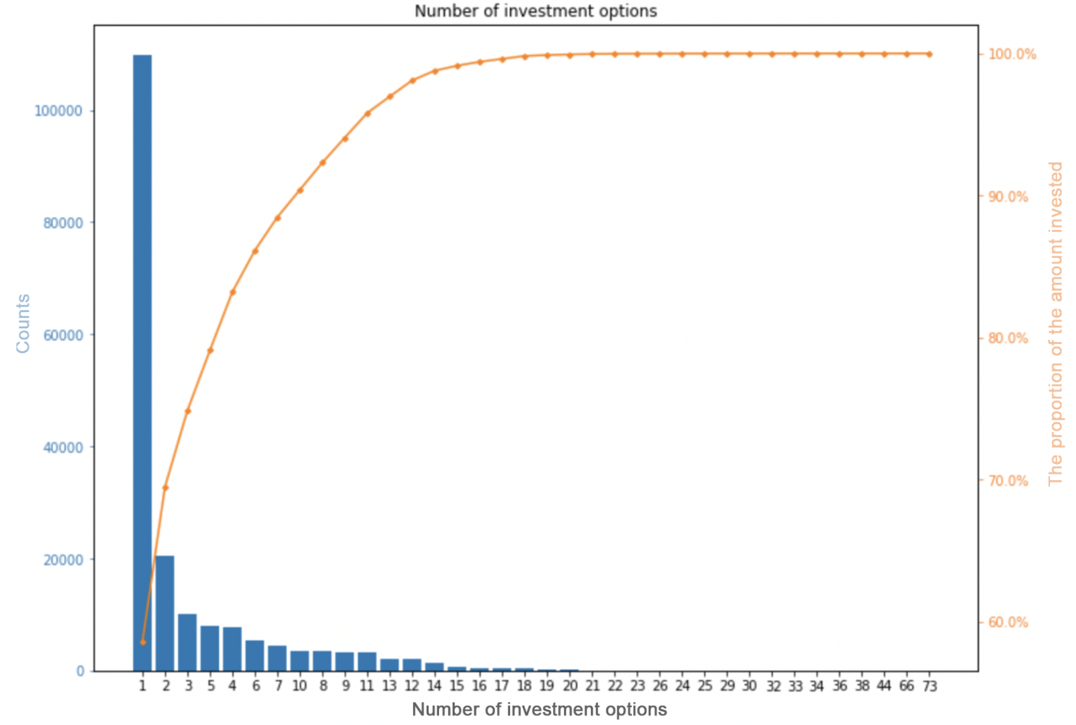
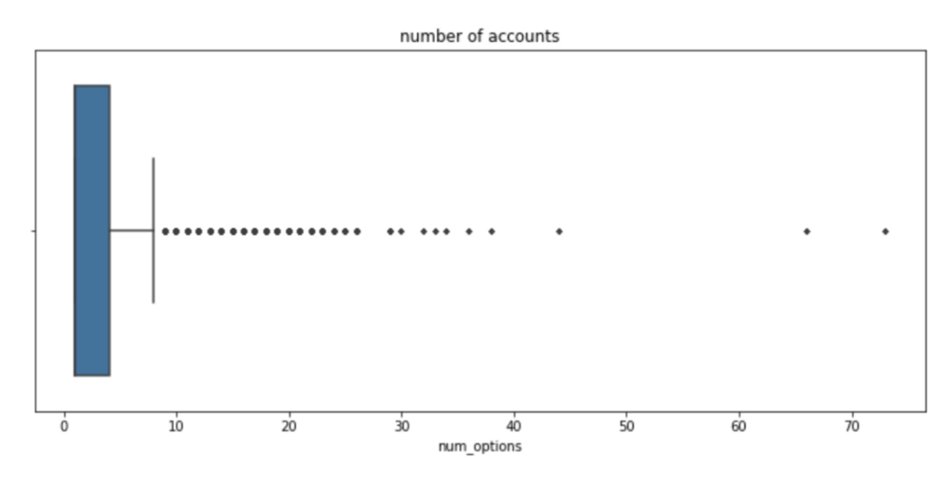
Initial Finding
Churn Analysis
Observation:
The customers who chose only one investment are the most, accounting for about 60% of the total
Those with less than ten investments account for 90% of the total
More than ten investments seem to be outliers.

Slide 15
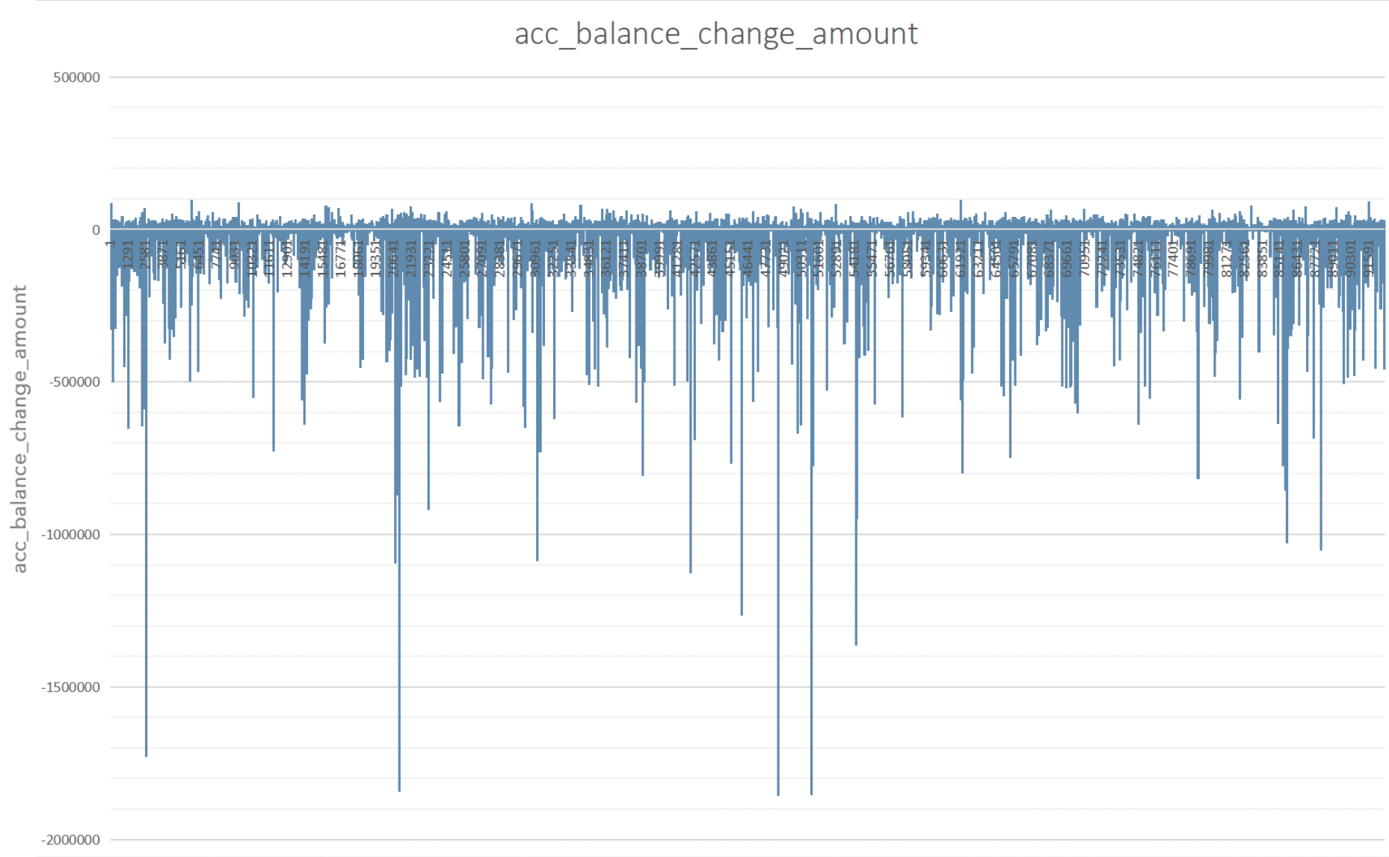
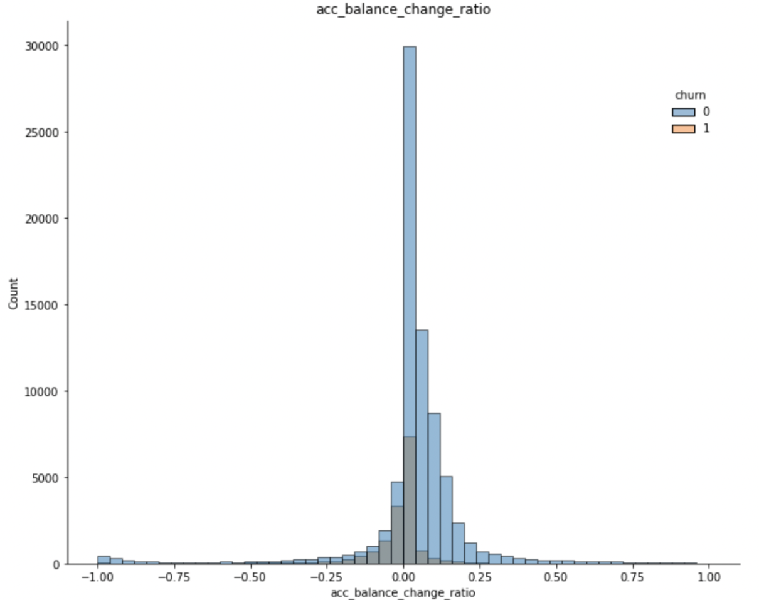
Initial Finding
Churn Analysis
Observation:
Can be found that there are many members' account balance changes showing a negative growth
Negative growth in the balance change are usually also churners

Slide 16
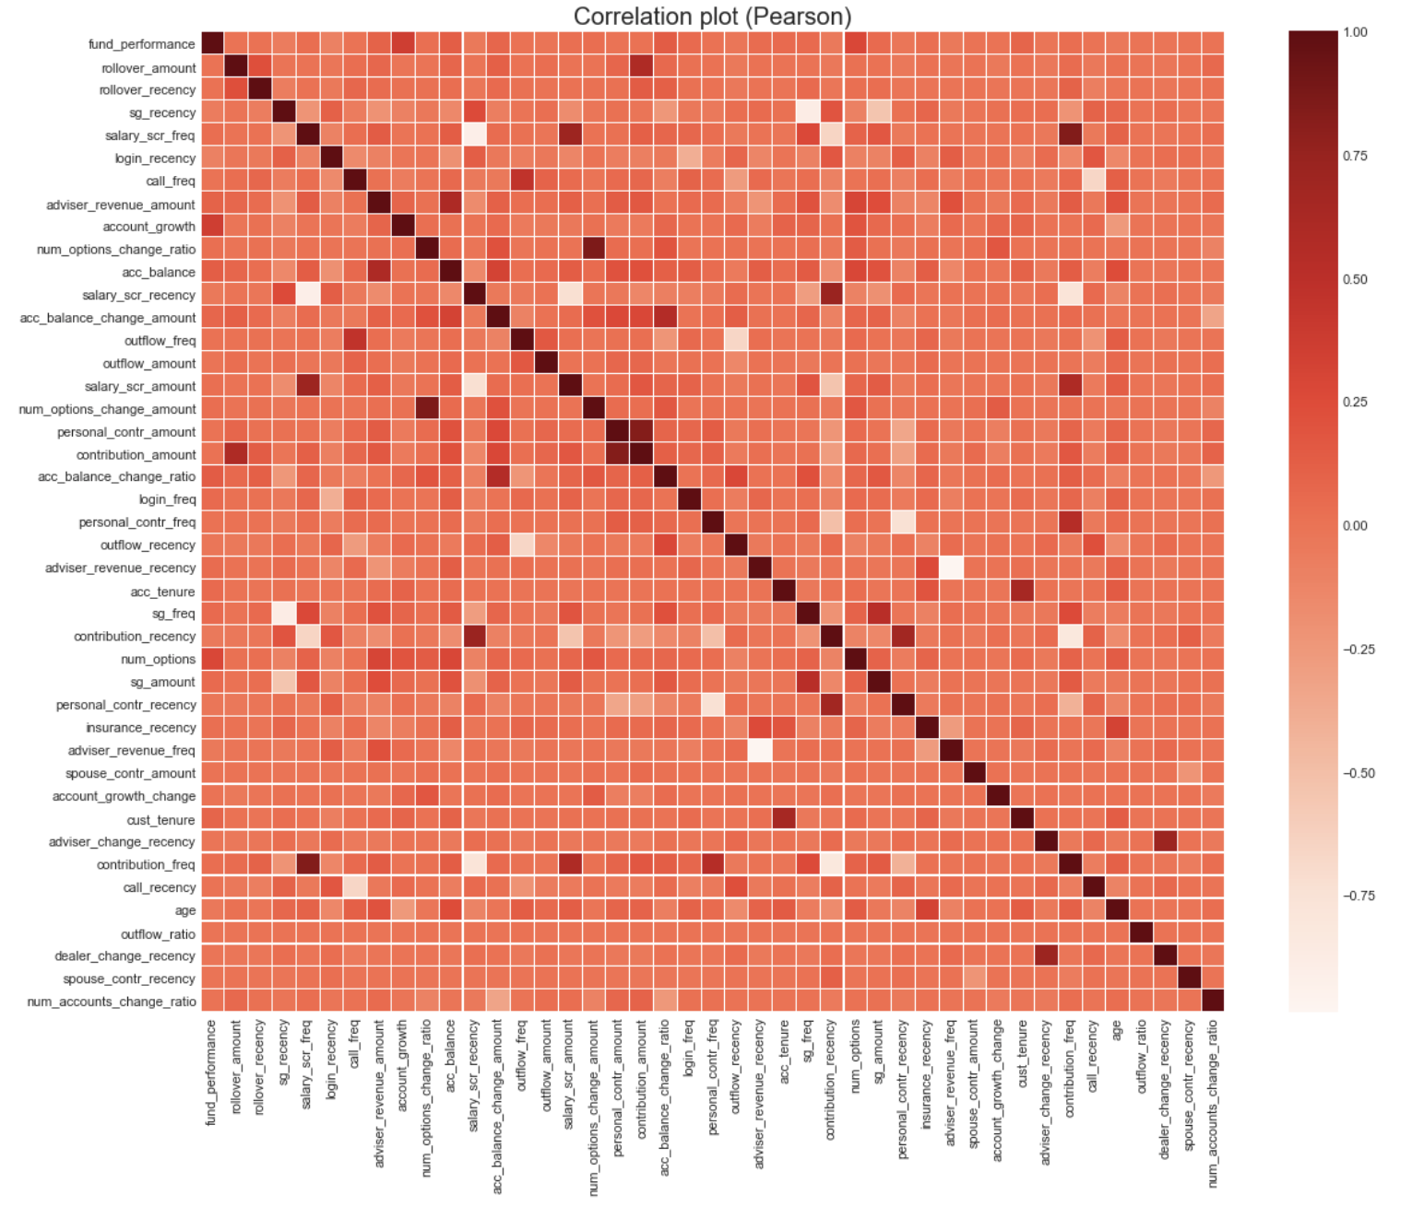
Initial Finding
Churn Analysis
Observation:
Some attributes show a strong relationship, such as salary_scr_freq and salary_scr_amount, insurance_types and insurance_recency and so on.
Some attributes show a strong negative correlation, such as salary_scr_freq and salary_scr_recency, adviser_change_freq and adviser_change_recency and so on.

Slide 17
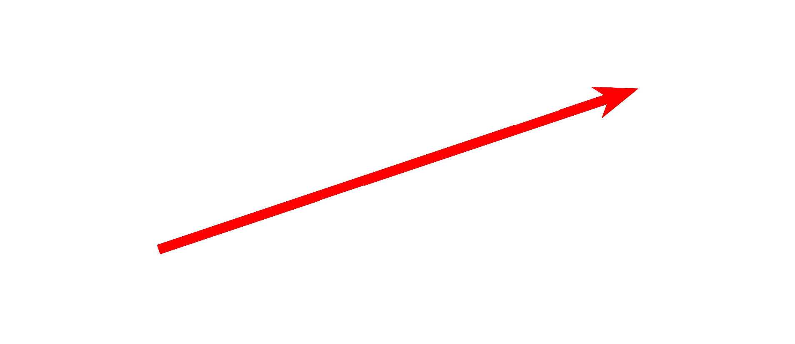
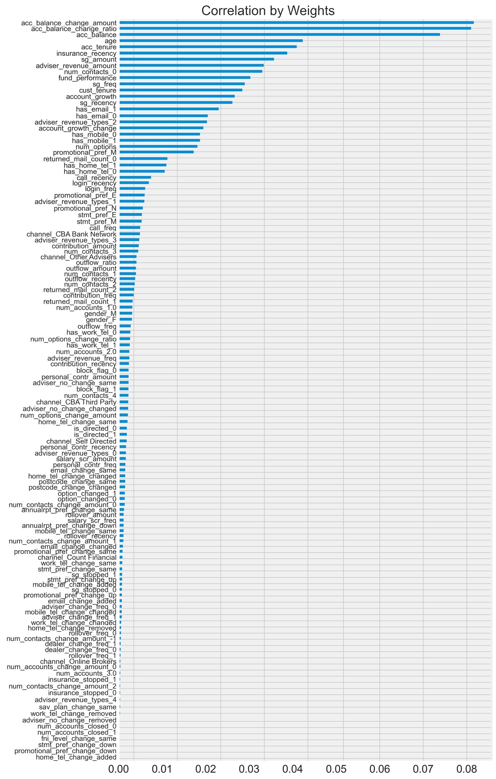
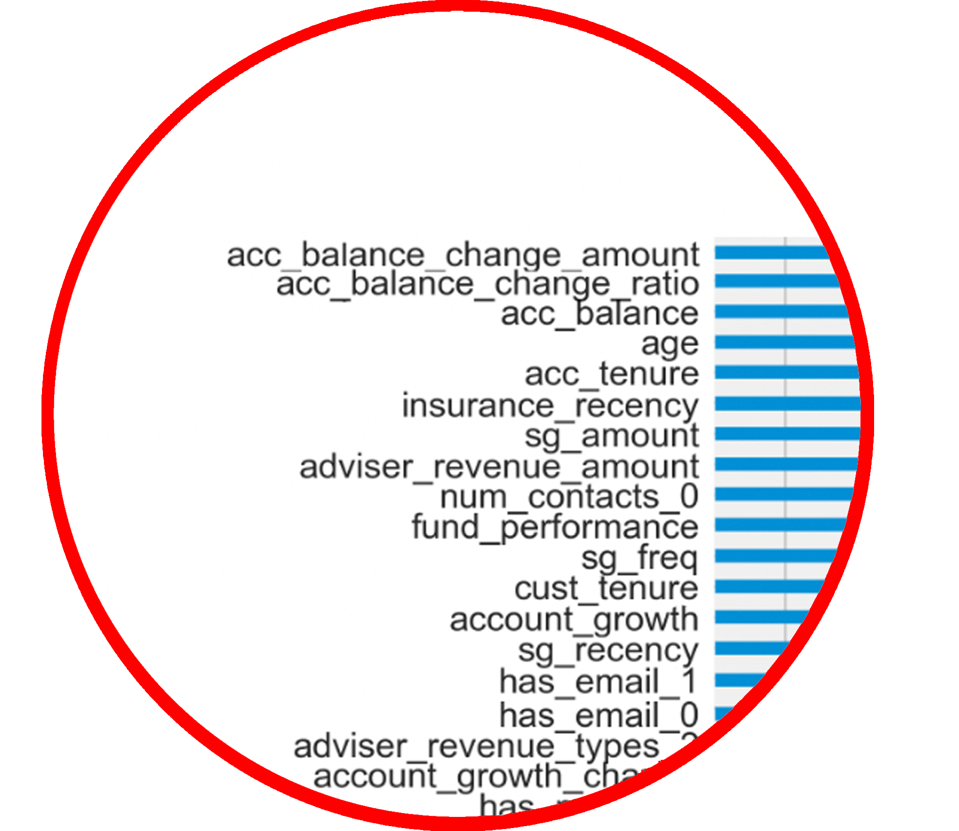
Initial Finding
Churn Analysis
Observation:
Some features have the most significant on customer churn, such as: acc_balance_change_amount, acc_balance_change_ratio and acc_balanceand .etc.
Some attributes have no effect on the customer churn, such as:
home_tel_change, promotional_pref_change_down,
work_tel_change .etc.

Slide 18
4.0 Challenges Encountered
What challenges have we encountered so far?
How did we overcome them?
Risks and mitigation

Slide 19

Challenges Encountered
Churn Analysis
What challenges we encountered so far? And how we overcome them?
Data Complexity:
Through data preprocessing such as One-Hot Encoding and normalization
To eliminated redundant data, accelerated the speed, and improved the model’s performance
Model Performance Issues:
Used voting ensembles to improve the performance of the model
Random forest is used for feature selection to delete unimportant features
Imbalanced Dataset:
Applied the SMOTE method for data training
To analyze the minority class and add new samples to the dataset based on the minority class sample
Improving the prediction ability of the minority class

Slide 20

Challenges Encountered
Churn Analysis
Risks and mitigation:
Misunderstanding customer requirements :
Proactively communicating with clients and acknowledging that updating our project schedule will help get their exact requirements and expectations
Lack of professional skills of team members :
Frequent group meetings to keep the project updated and ensure that the team leader assigns tasks based on the team members' proficiency
Absence of a meeting:
Having a separate communication with the team leader to ensure that the progress of the project can be followed
Conflicts of opinion among team members:
Being patient with the opinions of other team members, expressing their differences, and summarizing problems to resolve conflicts of views

Slide 21
5.0 Updated Project Plan
What has been accomplished so far?
What’s the next plan? Are there any changes?

Slide 22
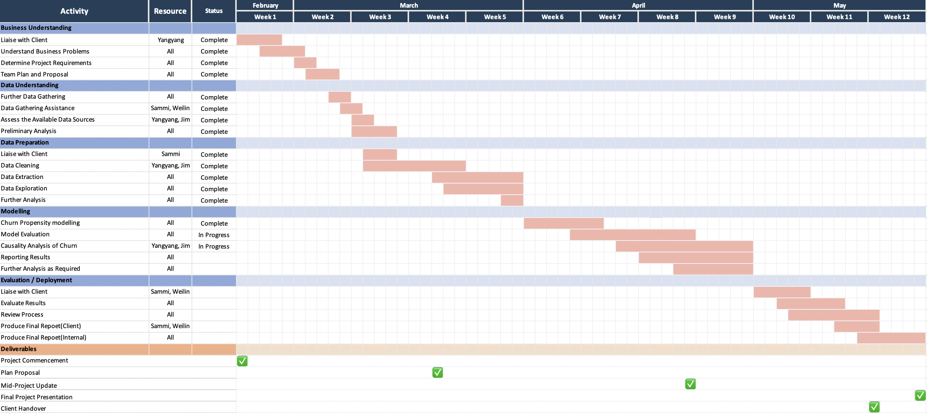
Updated Project Plan
Churn Analysis

Slide 23

Thanks for your listening
Reported by Group 18
Supervisor: David Hason
Speakers: Yangyang, Weilin, Jim, Sammi
The report date: 04/20/2022

